Slide 1
Unit-III Dynamic Programming
CS-402
Analysis Design of Algorithm

Slide 2
Syllabus
Concept of dynamic programming, problems based on this approach such as 0/1 knapsack, multistage graph, reliability design, Floyd-Warshall algorithm

Slide 3
Dynamic Programming (DP)
Dynamic Programming (DP) used to solve optimization problem.
Breaks down the complex problem into smaller subproblems.
Finds optimal solution to these subproblems.
Store the results of subproblem
Memorization: Top-down approach (Recursive)
Tabulation: Bottom-up approach (Iterative)
Reuse the stored result to avoid re-computation.
Finally calculate the result of complex problem.
Applicable to problems which are having properties of:
(i) Overlapping subproblems and (ii) Optimal substructure

Slide 4
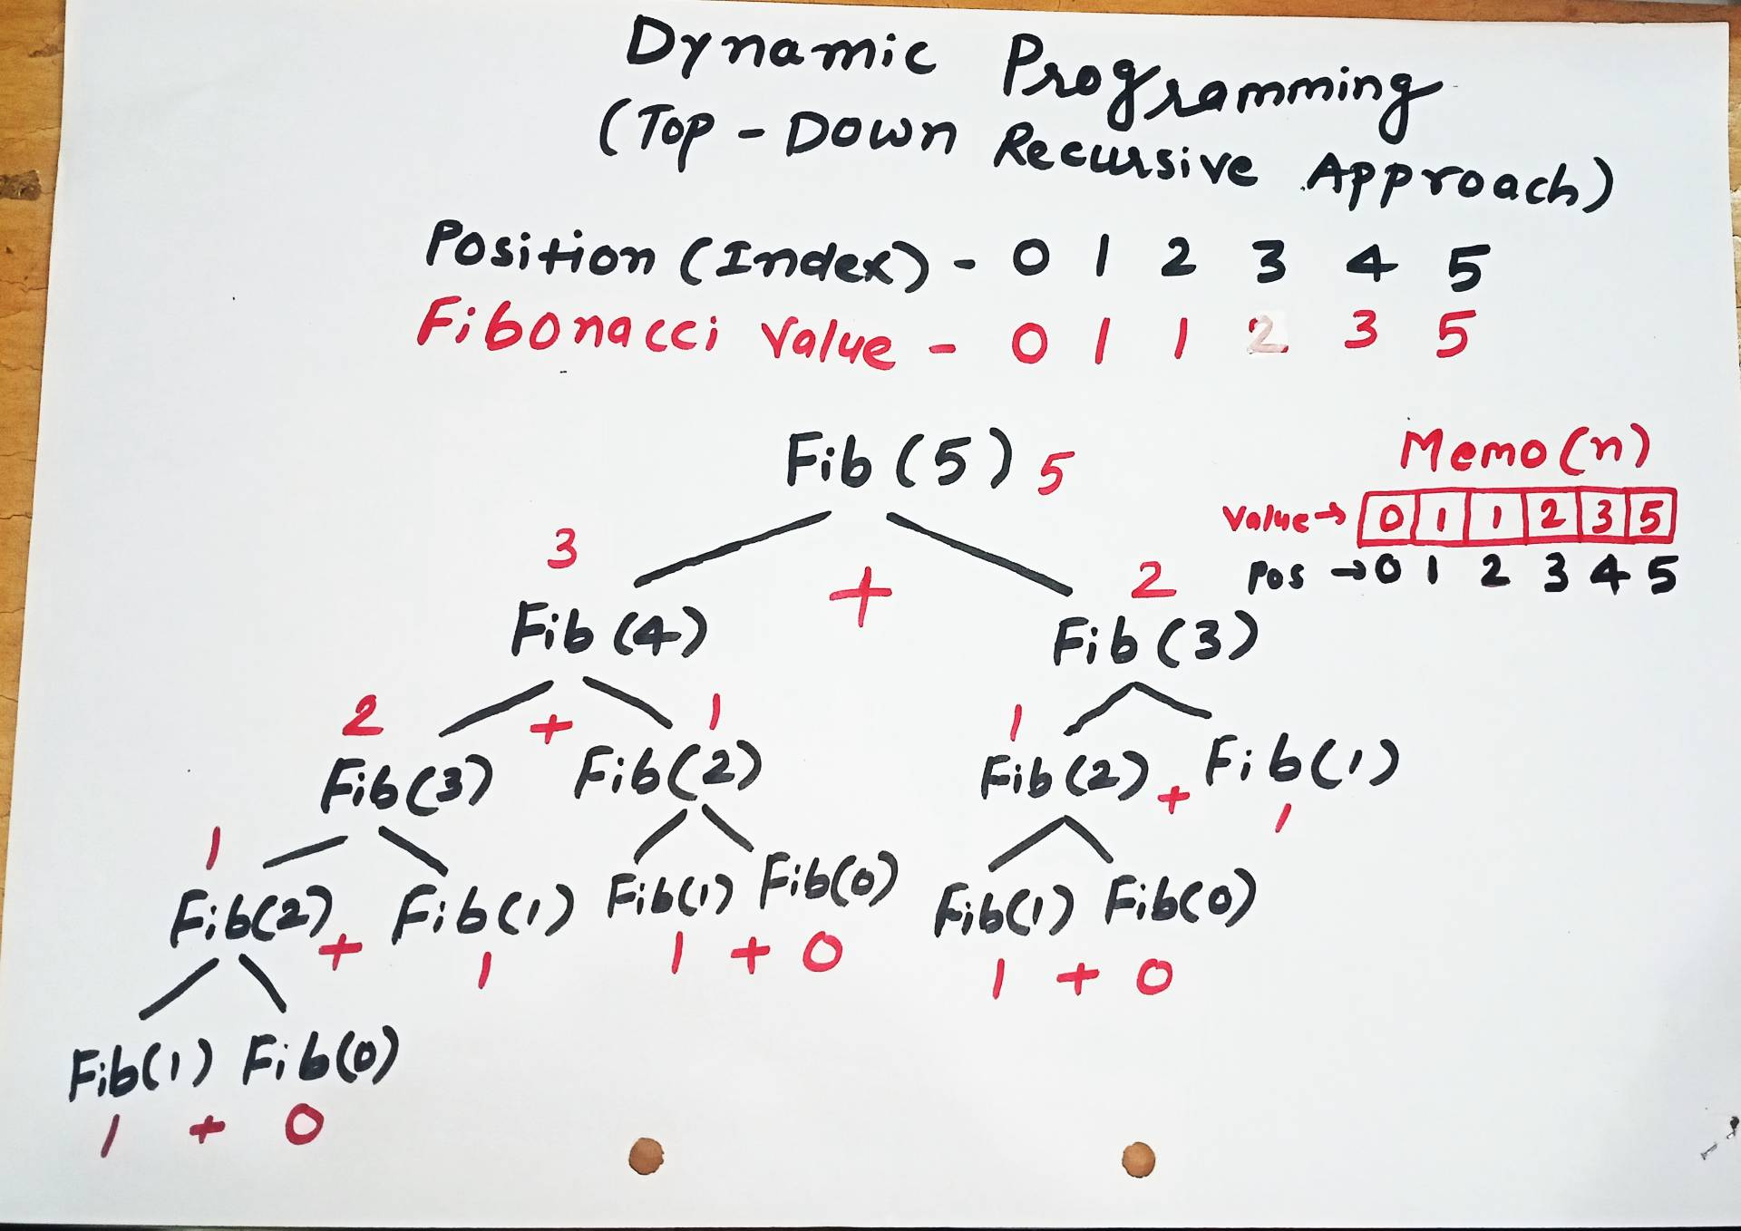
Memorization

Slide 5
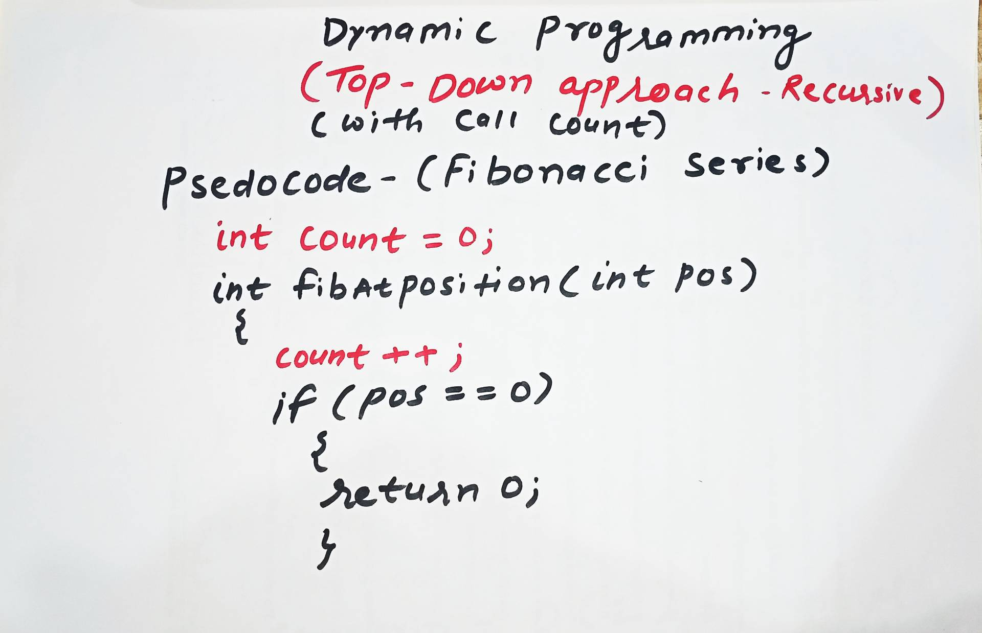
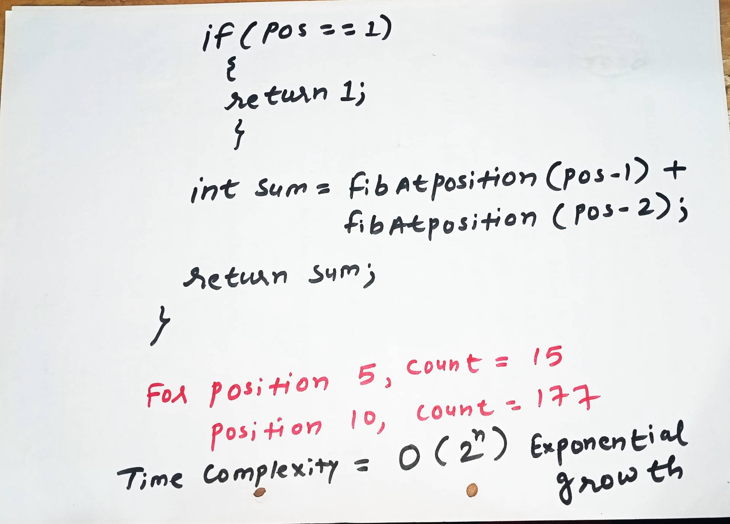
Without Memorization

Slide 6
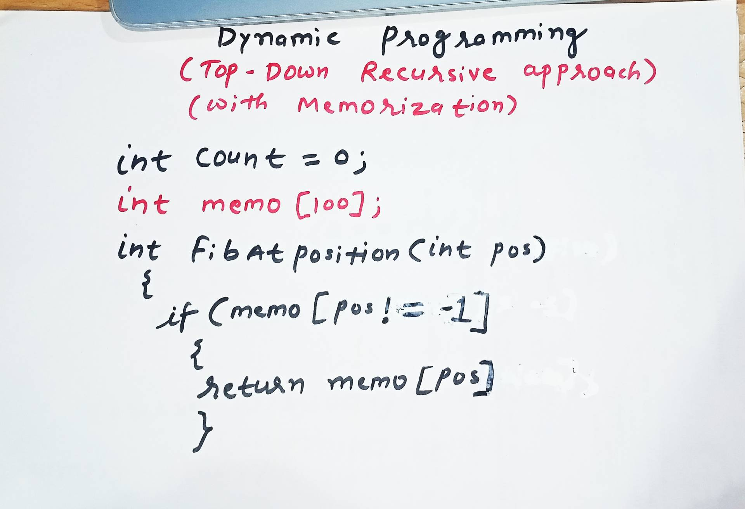
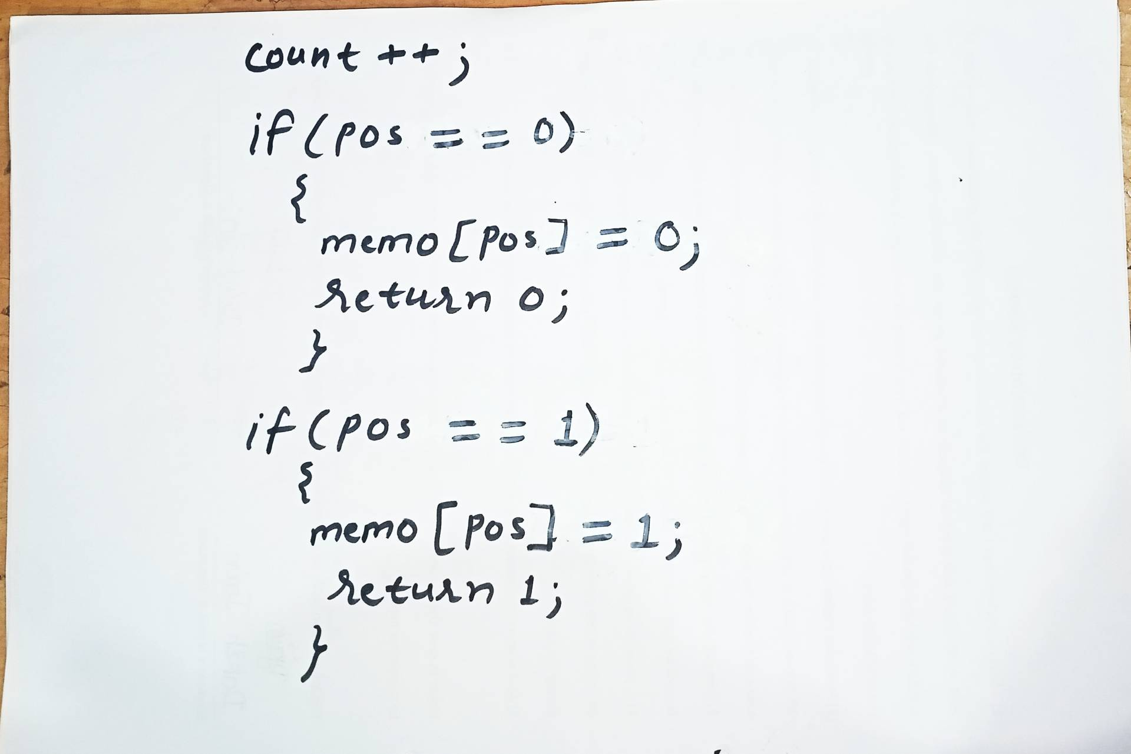
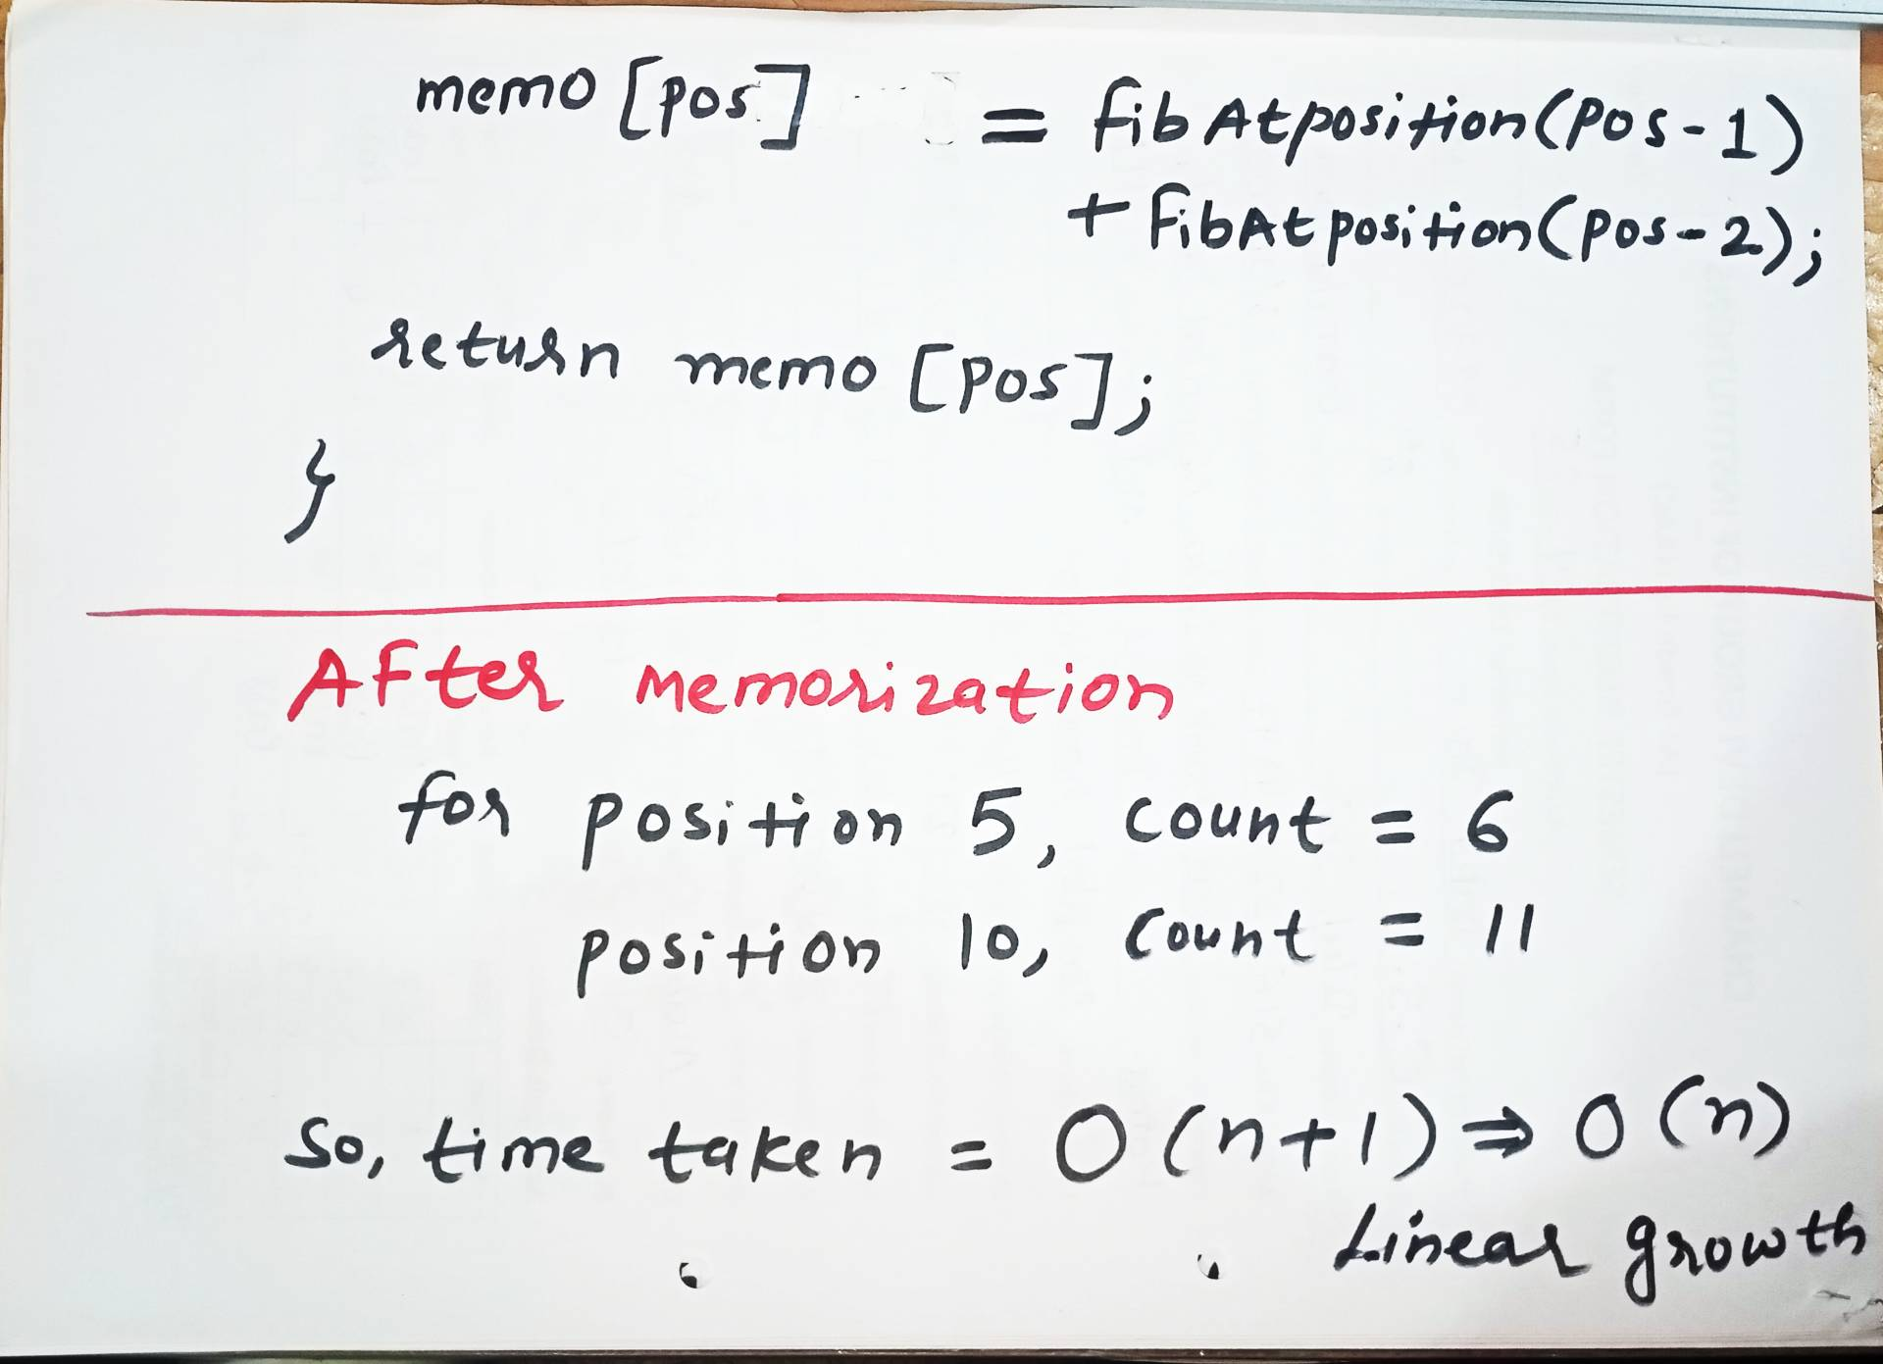
With Memorization

Slide 7
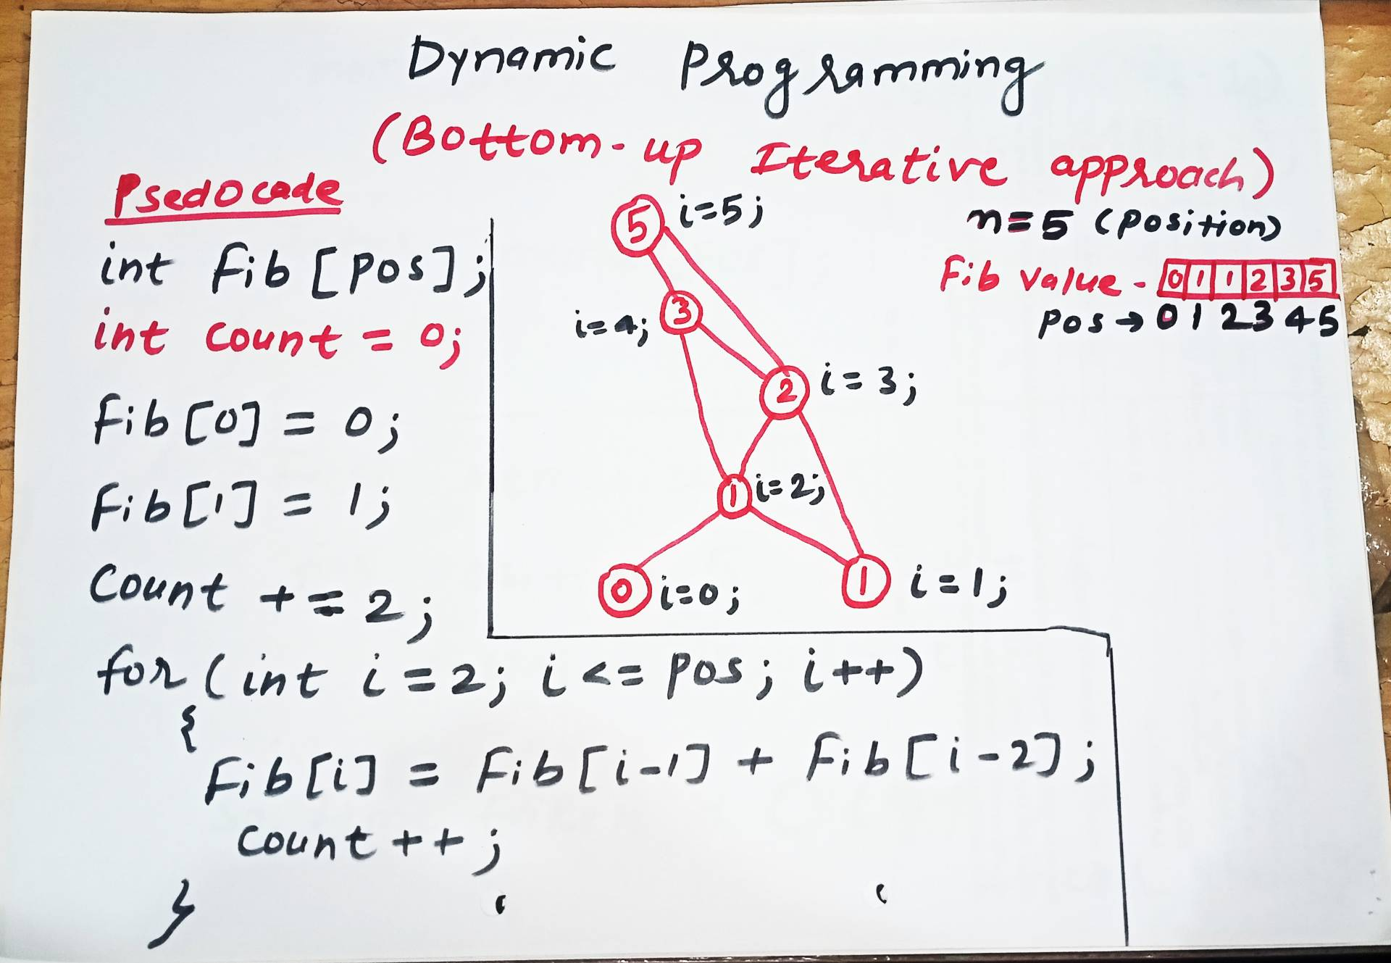
Tabulation

Slide 8
Problems based on Dynamic Programming Approach
0/1 knapsack
Multistage graph
Reliability design
Floyd-Warshall algorithm

Slide 9
0/1 Knapsack Problem
The 0/1 Knapsack Problem is a classic optimization problem in computer science where you must select a subset of indivisible items to maximize total value without exceeding a maximum weight capacity. The name "0/1" comes from the rule that you cannot take a fraction of an item; you must either leave it (0) or take it entirely (1).

Slide 10
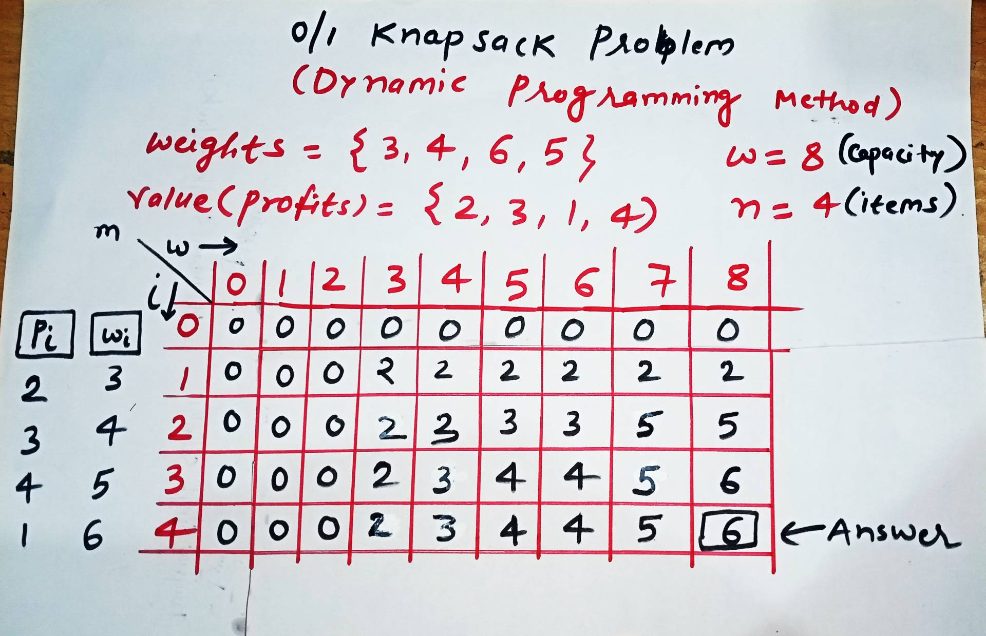
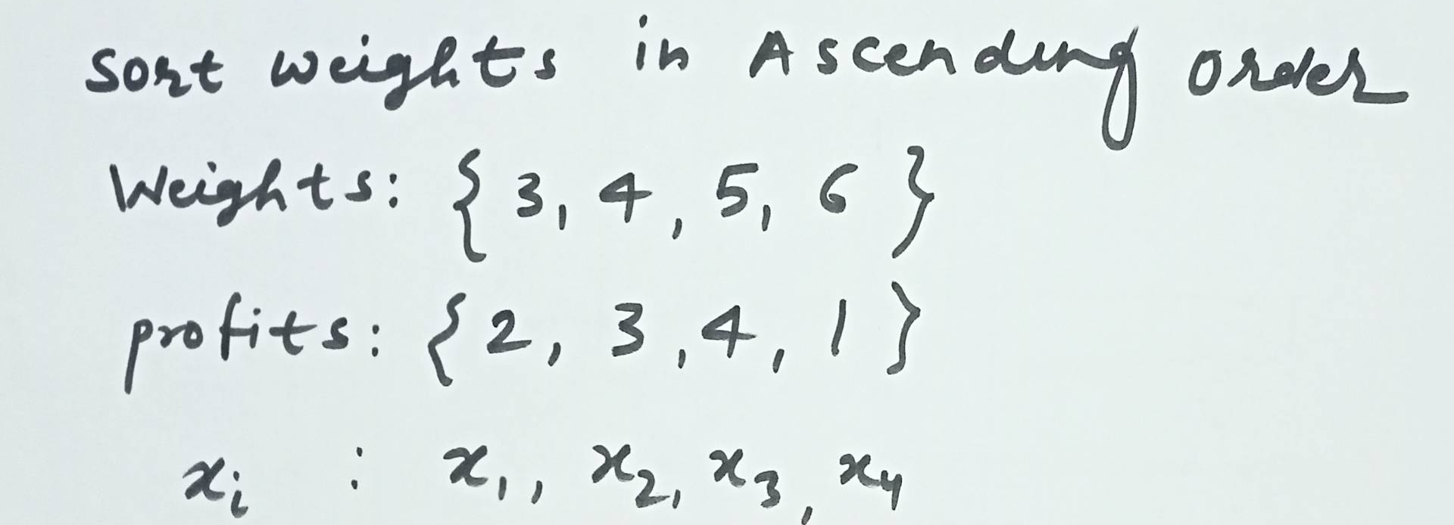
0/1 Knapsack

Slide 11
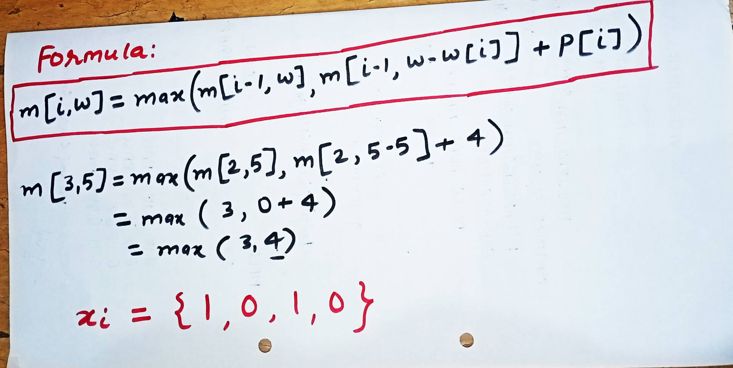
0/1 Knapsack

Slide 12
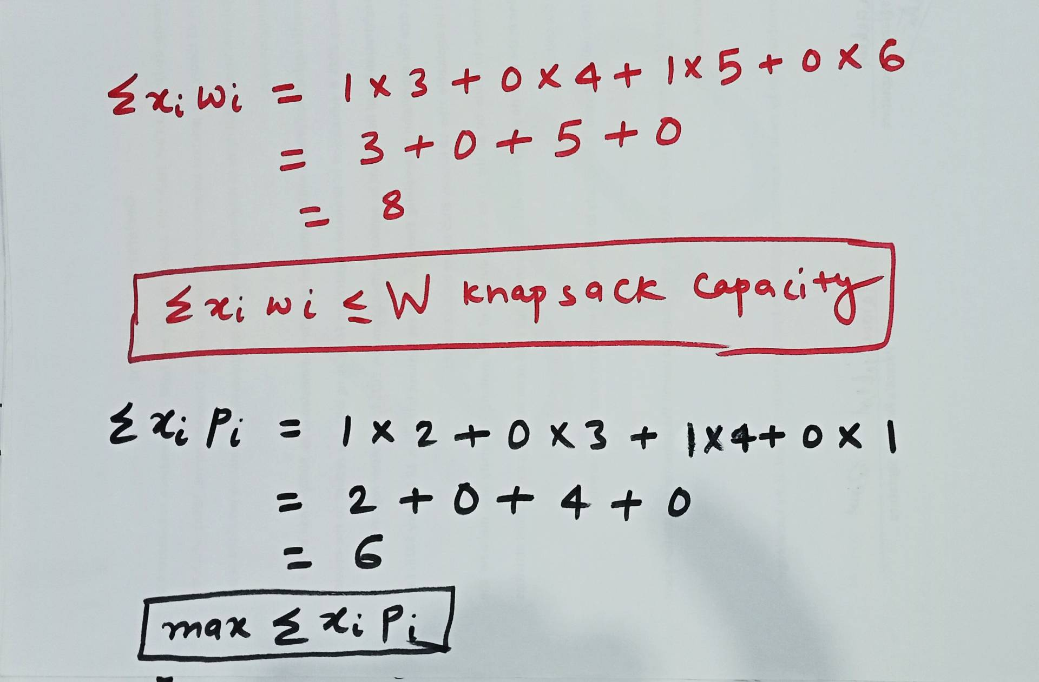
0/1 Knapsack

Slide 13
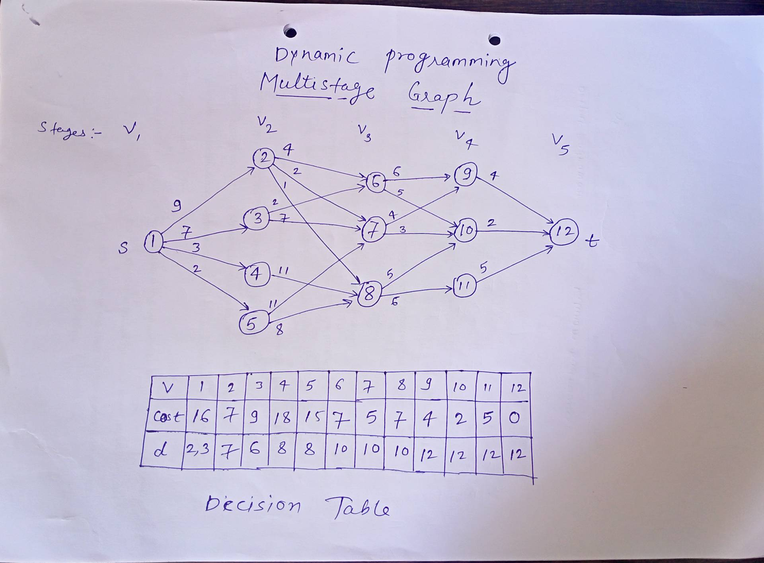
Multistage graph

Slide 14
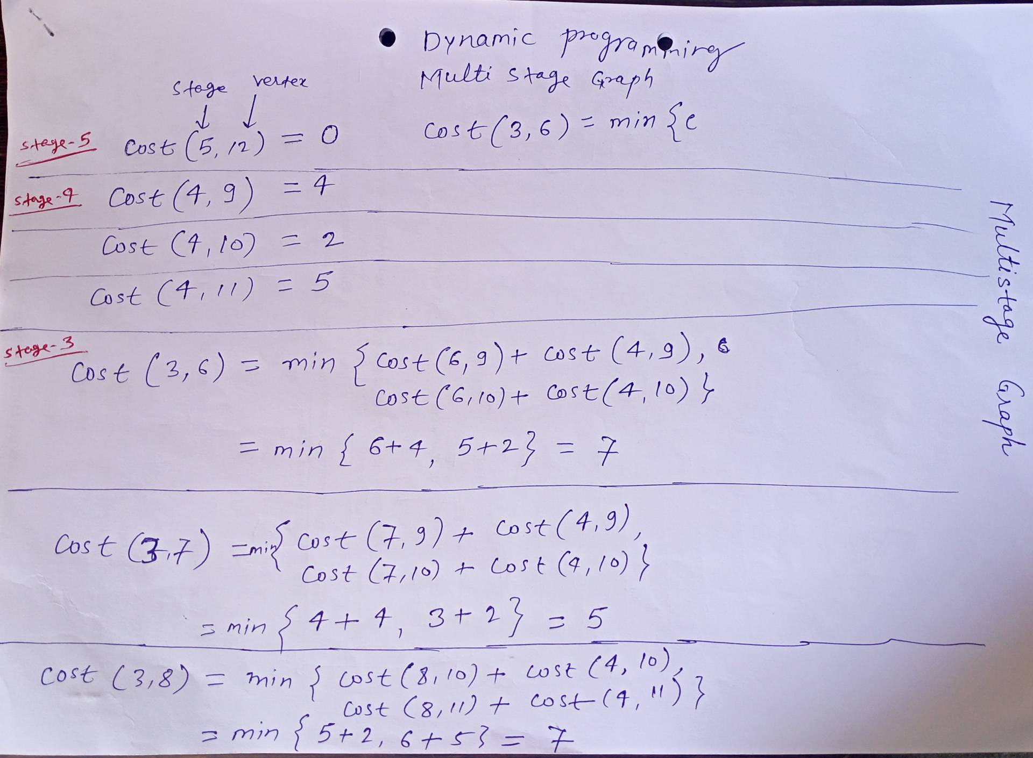
Multistage graph

Slide 15
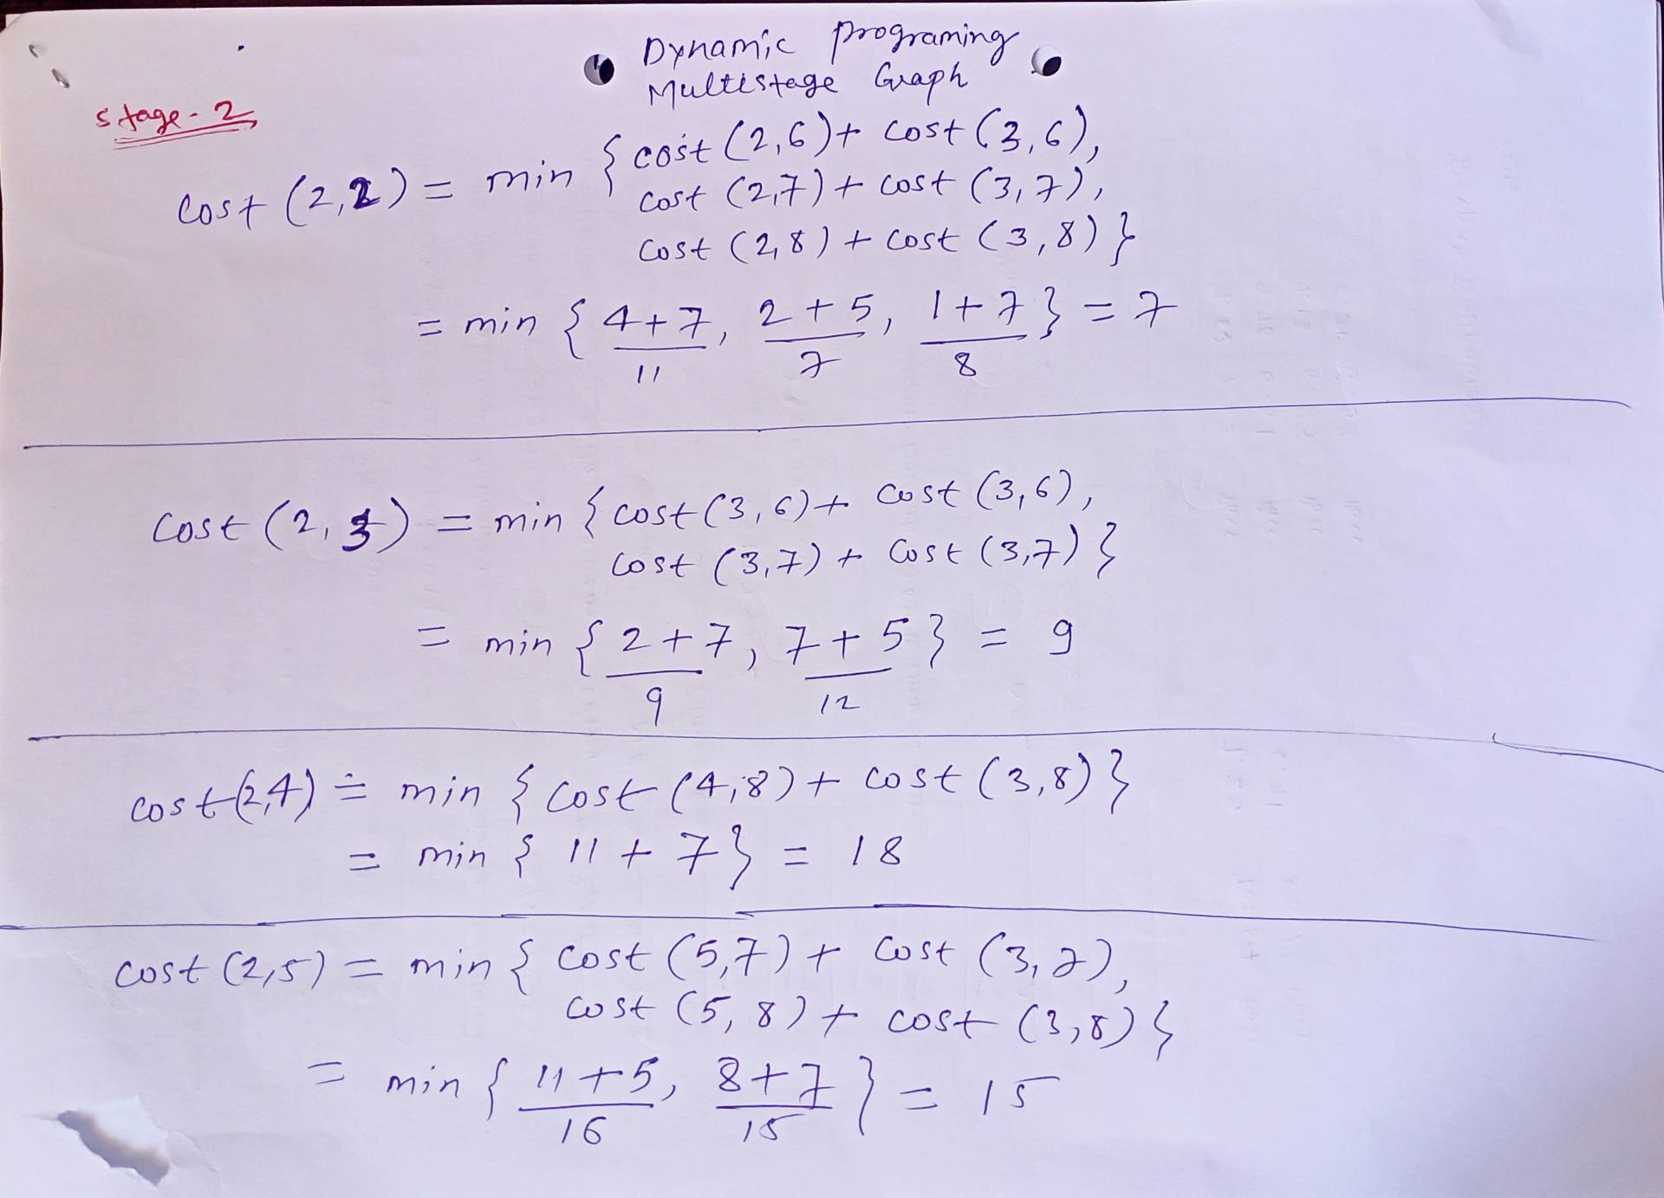
Multistage graph

Slide 16
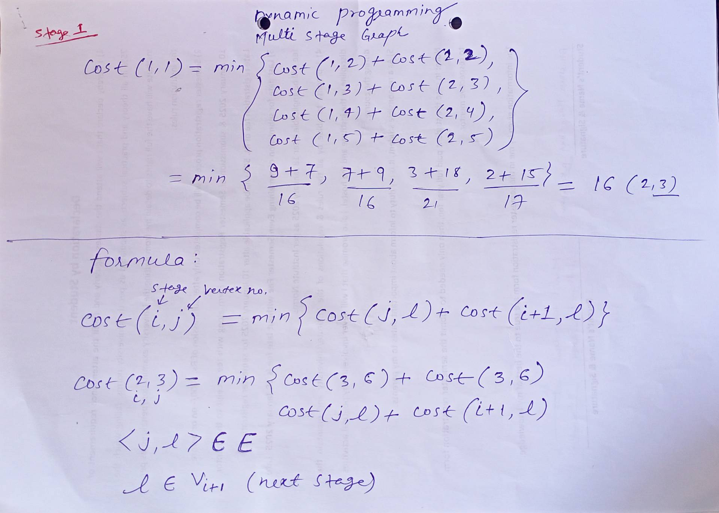
Multistage graph

Slide 17
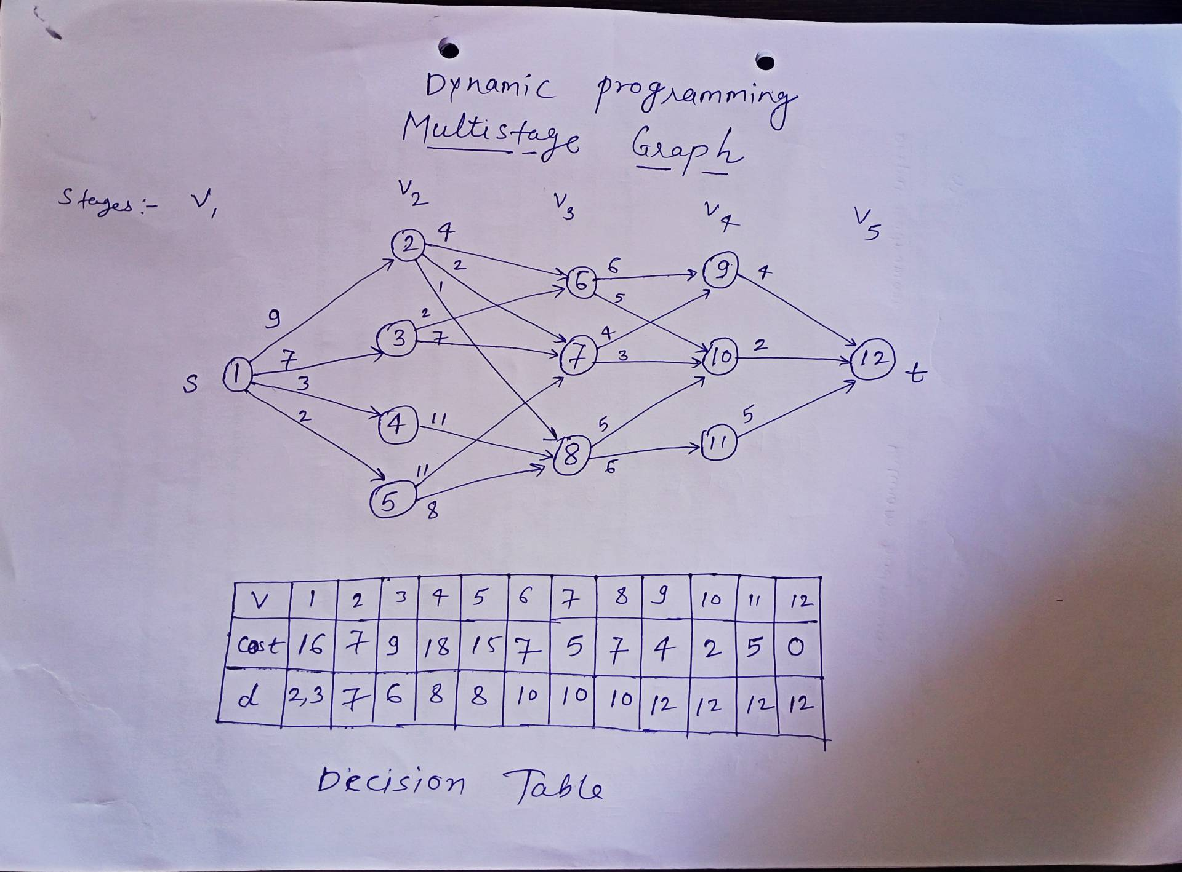
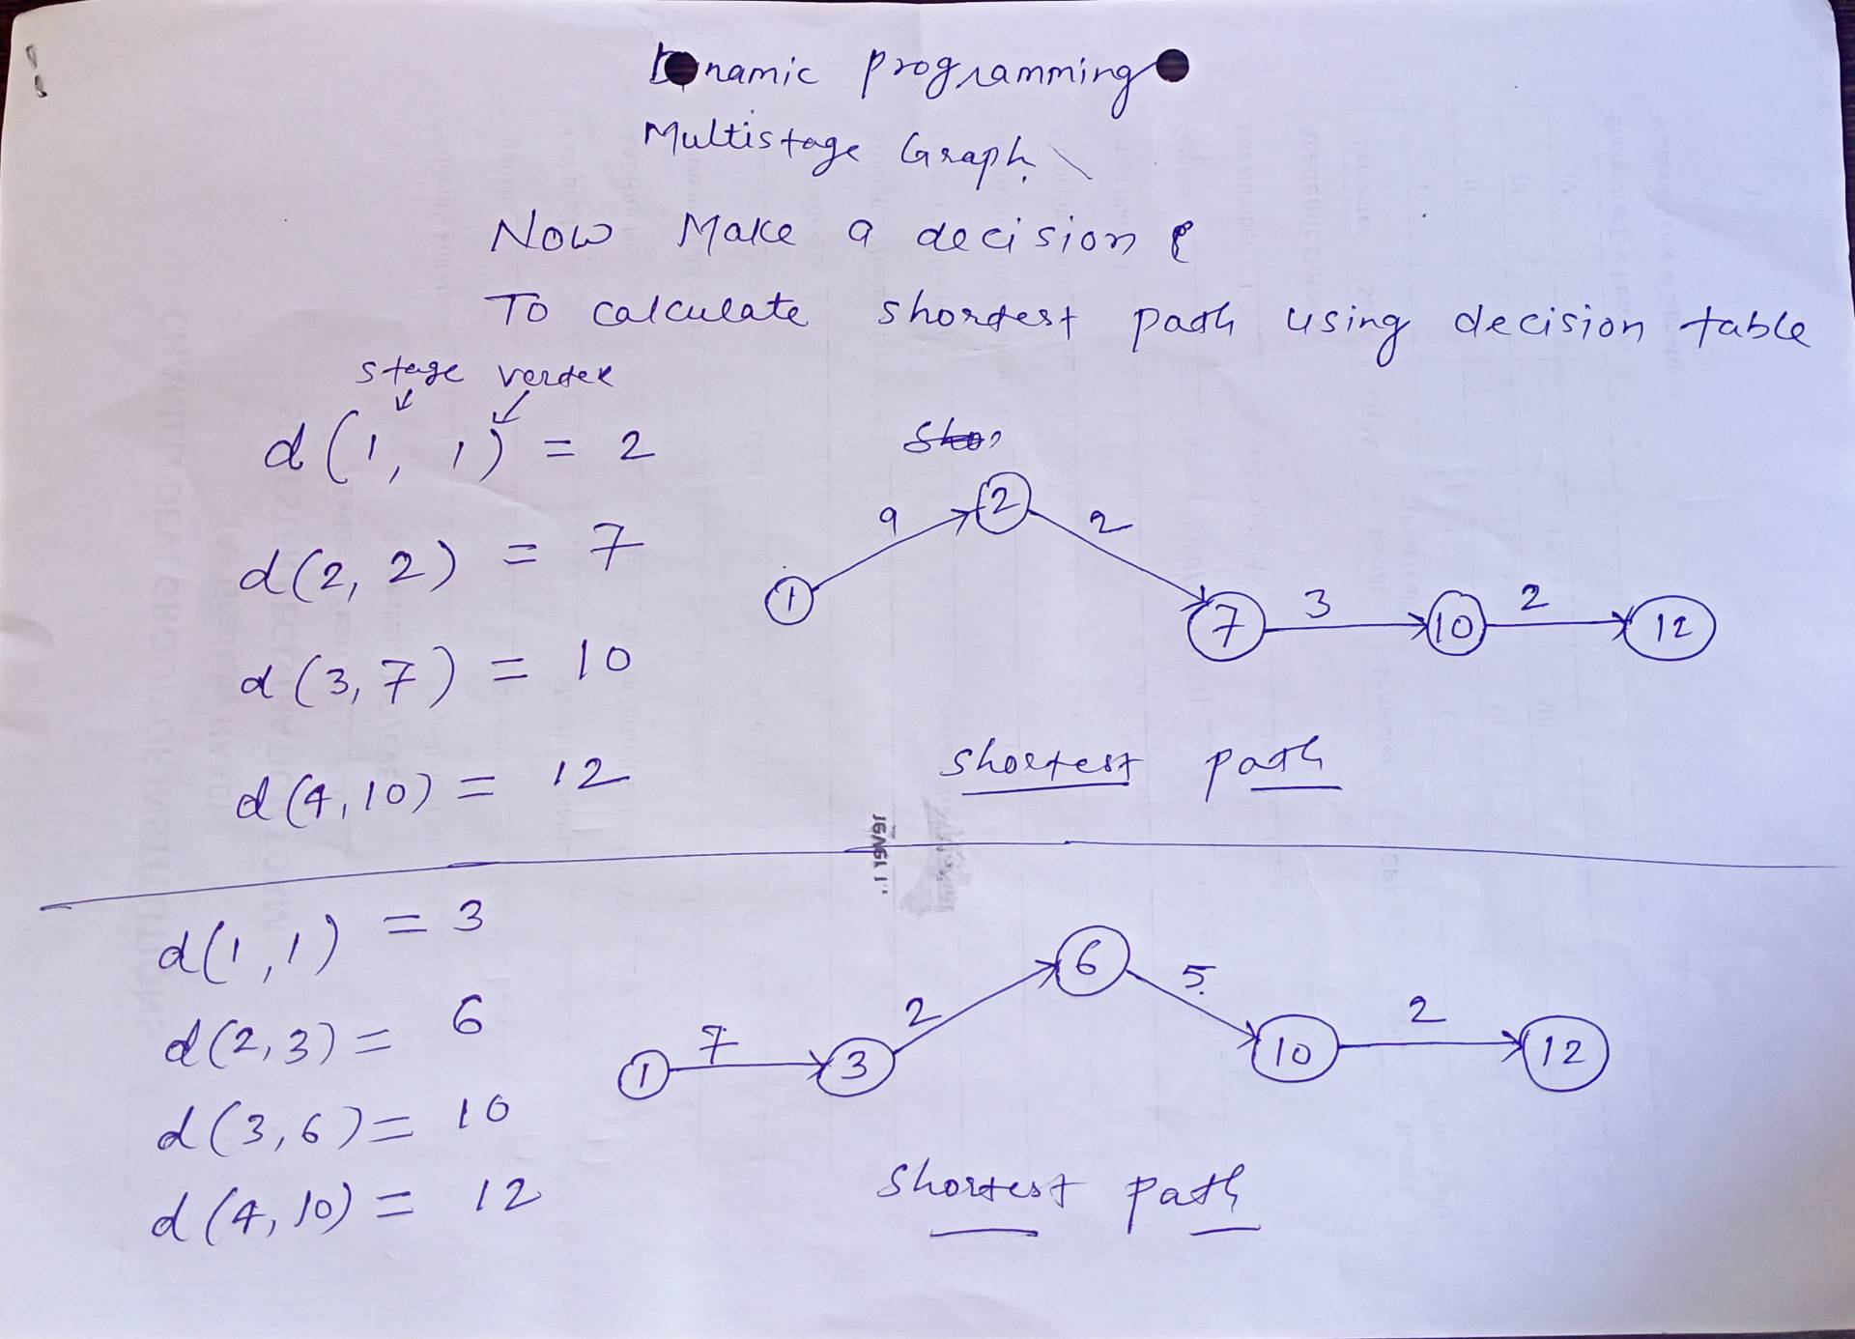
Multistage graph

